Slide 2
Career /Life Management Skills Presented by:
Asst.Prof. Madhu Bhushan
(Management Department)
Specialization –Marketing & HR
Academic Qualification-NET,MBA,
DIP T D(Ministry of HRD)(GOLD MEADALIST)

Slide 3
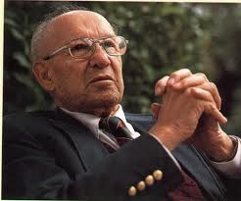
Thoughts
Great things are not done by impulse but by a series of small things brought together.
Life consists not in holding good cards but in playing those you hold well.

Slide 4
Life Management skills for success
Career Planning- Balance between work & personal (leveling the scale)
Interpersonal skills
Networking
Leadership
Volunteer

Slide 5
Failing to plan is simply planning to Fail
Health, Family, Vacation, Hobbies/stress relief
Deadlines, workload, overtime, training
.Work career plan-Technical, Management.
To deny or ignore this balance is setting yourself for disappointment or dis-ease
You must be always be training for next level up if you wish to advance

Slide 7
Communication Skills
Listening to understand- accept , clarify , ask , summarise
Conveying ideas-state purpose , convey meaning
Feeling dearly , check for understanding ,focus discussion , summarize
Different communication styles
Different communication channels
Negotiated-Problem solving, focus on situation not on personalities, be patient

Slide 8
Dig your well before you are thirsty
Networking
Why, with whom , what will I be able to contribute , gain ? when/where
Follow up with leaders , acknowledge source
Thanks contacts
Do what you promised to do
Keep your antenna up

Slide 9
Leadership is not about position :its about doing
Live & work in scientific ways
Promote innovation
Influence & guide
Focus on real work
Deal with tough situations

Slide 10
Conflict & negotiation are central parts of organization life
Conflict is unavoidable and common
Negotiation is primary key to resolve
Situations:
Win/Win-Healthy conflict, when brings new ideas and relationships
Win/Lose- distrust, anger, withdrawl
Handling Conflict
Competing-assert your opinion
Avoiding-ignore,sense of timing
Collaborating-full satisfaction both sides
Accomodating-forgoing,concerns
Compromising-finding middle ground

Slide 11
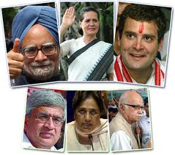

Slide 12
Office Politics
You have to play politics always . Remember there is good politics and there is bad politics
Managing your boss
Nobody wins unless everybody wins
Focus on target
Who are your angels

Slide 14
What is your brand
You cannot be all things to everybody. Understand your strengths and create a positive branding of you.

Slide 15
Focus on Big Stuff
Do not burn your bridges
Time management
Relationship management
Career Management
Anger Management

Slide 17
Presentation Skills
Depth knowledge about topic
Communication skills
Use of technology
Be Expressive
Push yourself to front
Wear comfortable cloths but formal

Slide 18
Responsible Students
Set goals, stay focused on future
Pan Line-use calendar to keep all events, due dates
Study everyday-do it steadily
Take notes- Teaches almost always highlight what is important
Keep Commitments
Get ready ahead of time
Find your interest
Keep yourself updated

